Slide 1
Design and implementation of Convolutional Neural Networks for Low-Dose CT Image Noise Reduction
Thesis presentation by,
Seyyedomid Badretale
Supervisor:
Dr. J. Alirezaie

Slide 2
Outlines
Contributions
X-ray Computed Tomography (CT) overview
Problem definition
Overview of CT denoising methods
Methodology
Experimental Results
Summary and Conclusion

Slide 3
Contributions
Two CNN architectures are presented to remove noise from low-dose CT images.
First network is inspired by the dictionary learning methods and a function is assigned for each layer based on this correlation.
An efficient network is presented by improving the first architecture in terms of speed and the performance.
Important parameters for each network are investigated to find the best performance.
The models are tested and the results are compared to the state-of-the-arts methods.

Slide 4
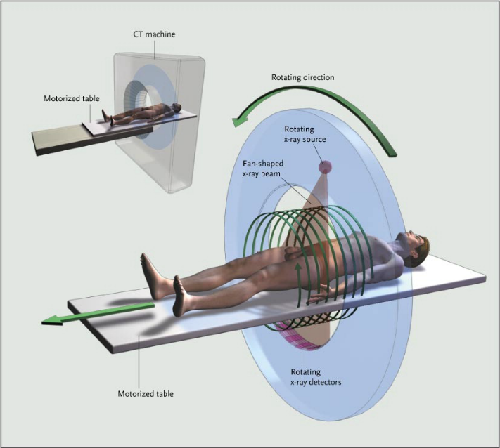
X-Ray Computed Tomography (CT) Imaging
Widely used diagnostic device
Can reveal bones as well as soft tissues.
Cross-sectional images
Produce 3D images
X-rays are ionizing beams
Harmful to tissues (DNA)
Higher cancer risk
Fundamentals of CT imaging [1]
Notes:
Background and the definition of X-Ray CT imaging
The main source of noise in X-ray projection data is the statistical fluctuations of X-ray quanta reaching the detectors.
This noise follows the Poisson distribution.
However, after the application of reconstruction algorithms and image processing steps to the projection data, the distribution of the noise in the resulting CT image is unknown and therefore is hard to model.
Problem statement and the importance of low-dose CT

Slide 5
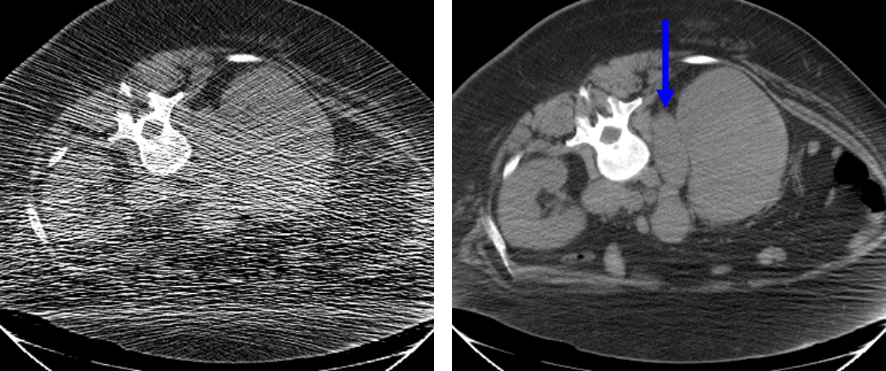
Radiation Dose and Image Quality
low mAs → few photons detected → more noise
(low-dose) (Photon starvation) (low SNR)
60 mA
440 mA
Computed tomography artifacts [2]

Slide 6
Related Works
Denoising applied to sinogram (projection data) [3]
Effective, but Not readily available and accessible.
Denoising applied to the reconstructed image.
Wavelet [4]
Total Variation [5]
Dictionary Learning and Sparse Representation [6,7]
Literature Review
Wikipedia: Machine learning […] gives “computers the ability to learn without being explicitly programmed.”
Ingredients: smart algorithms, lots of examples (data), lots of computational power.
Deep learning

Slide 7
CNN in Medical applications
DICOM images
16-bits images
Image and info
Wide range of intensity
Medical noise vs Natural noise
Statistical property of low-dose CT images: Methods, such as median filtering, Gaussian filtering
Filter size
Too small : Less structural information
Too large : huge computational complexity and less size of the dataset, smoothing

Slide 8
Contributions
Two CNN architectures are presented to remove noise from low-dose CT images.
First network is inspired by the dictionary learning methods and a function is assigned for each layer based on this correlation.
An efficient network is presented by improving the first architecture in terms of speed and the performance.
Important parameters for each network are investigated to find the best performance.
The model is tested and the results are compared to the state-of-the-arts methods.

Slide 9
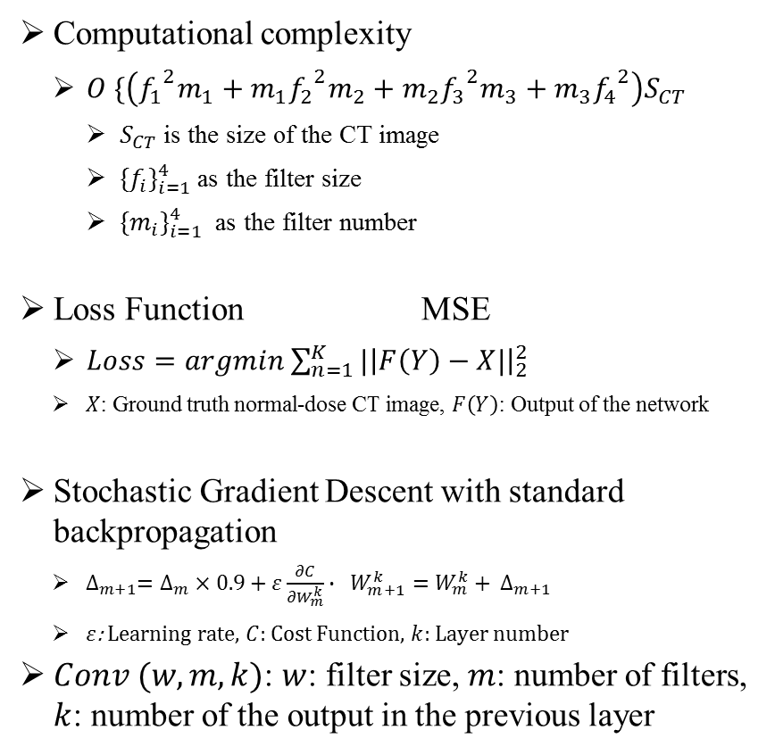
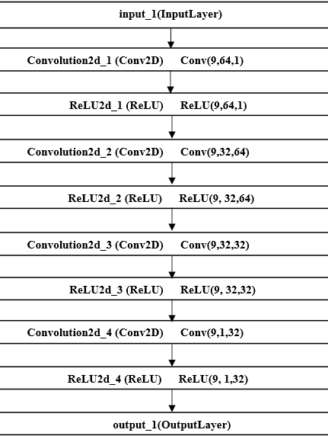
Proposed Low-dose CT CNN (LDCNN)

Slide 10
from Dictionary learning to LDCNN
Extracting low-dose patches and project onto a low-dose dictionary
Iteratively processing low-dose coefficients in order to create the normal-dose coefficients
Projecting the normal-dose coefficients onto the normal-dose dictionary and averaging the overlapping patches

Slide 11
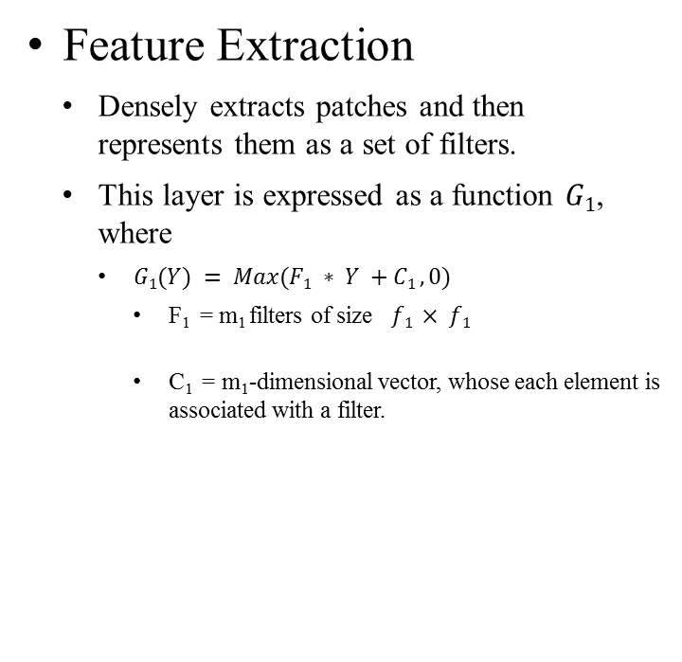
LDCNN Structure

Slide 12
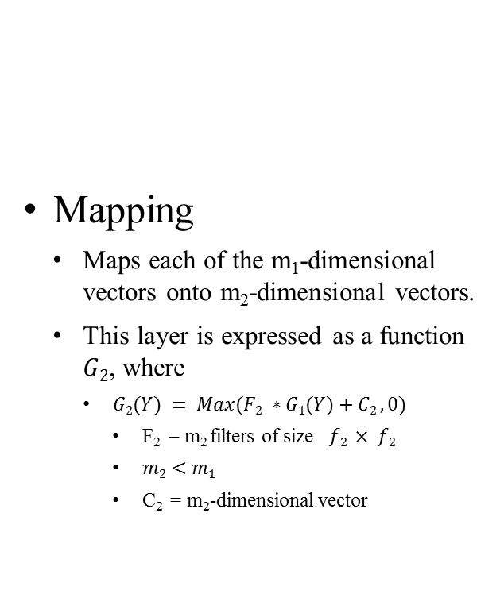
LDCNN Structure

Slide 13
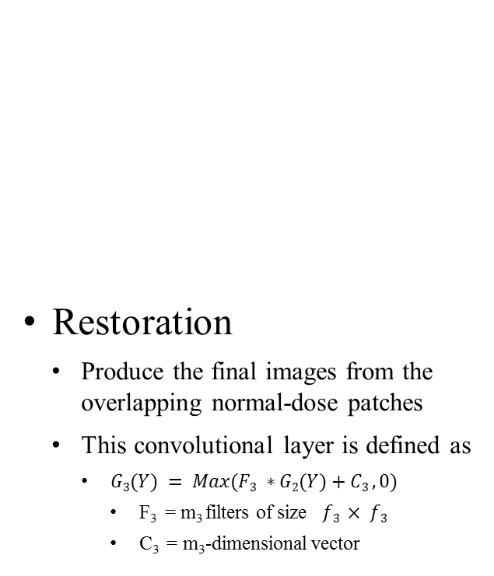
LDCNN Structure

Slide 14
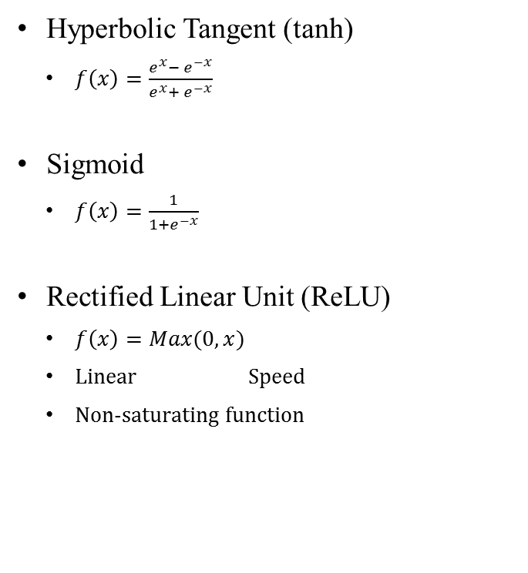
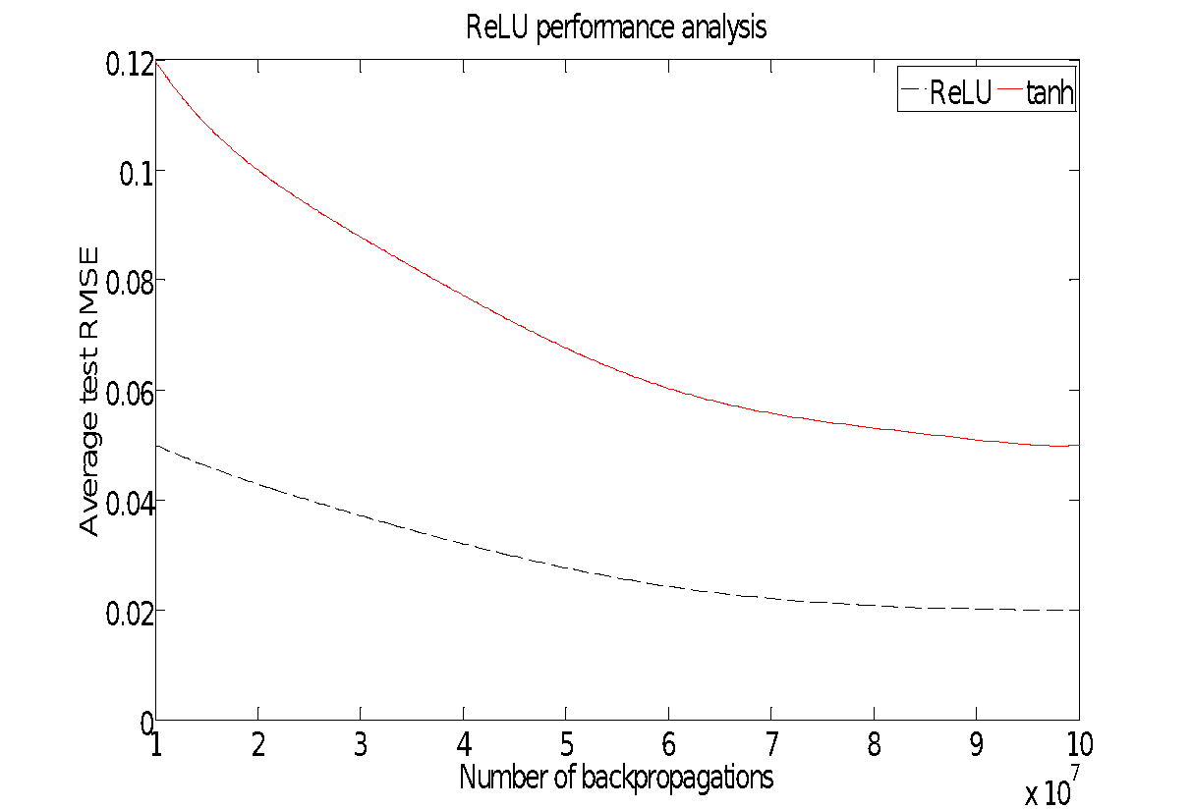
Activation Functions

Slide 15
Properties of the LDCNN
End-to-end mapping between the low-dose and normal-dose CT images
Fully feed-forward network, it is unnecessary to solve the optimization problem.
Trained hierarchically structured feature maps from low-level (blobs, edges, etc.) to high-level (more complex and detailed shapes) Transfer learning
Concise structure, but provides superior accuracy compared to state-of-the-art methods.

Slide 16
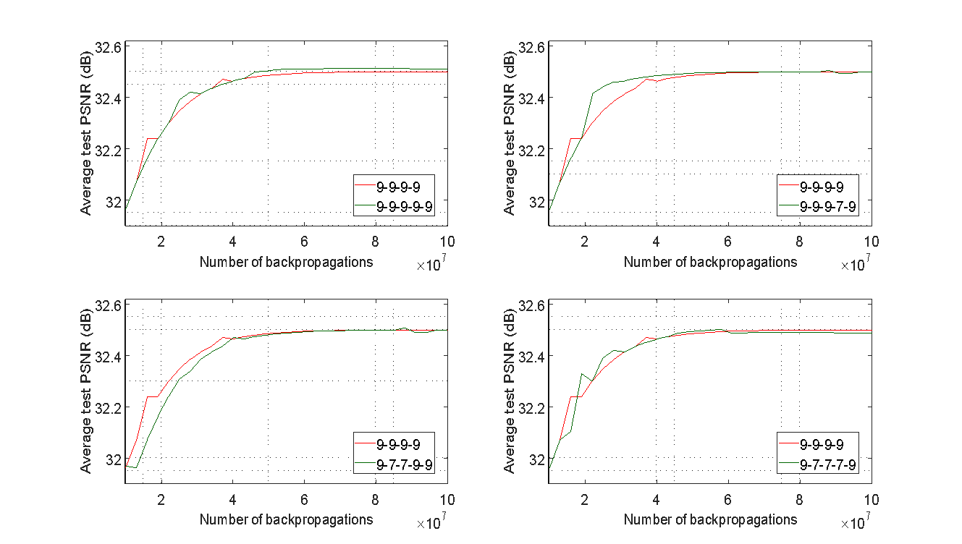
Network parameters and Efficiency
Number of layers

Slide 17
Network parameters and Efficiency
Number of feature maps
PSNR (dB) | RMSE | Parameters | PSNR (dB) | RMSE | Parameters | PSNR (dB) | RMSE | Parameters
32.14 | 0.16 |  | 32.11 | 0.19 |  | 32.01 | 0.27

Slide 18
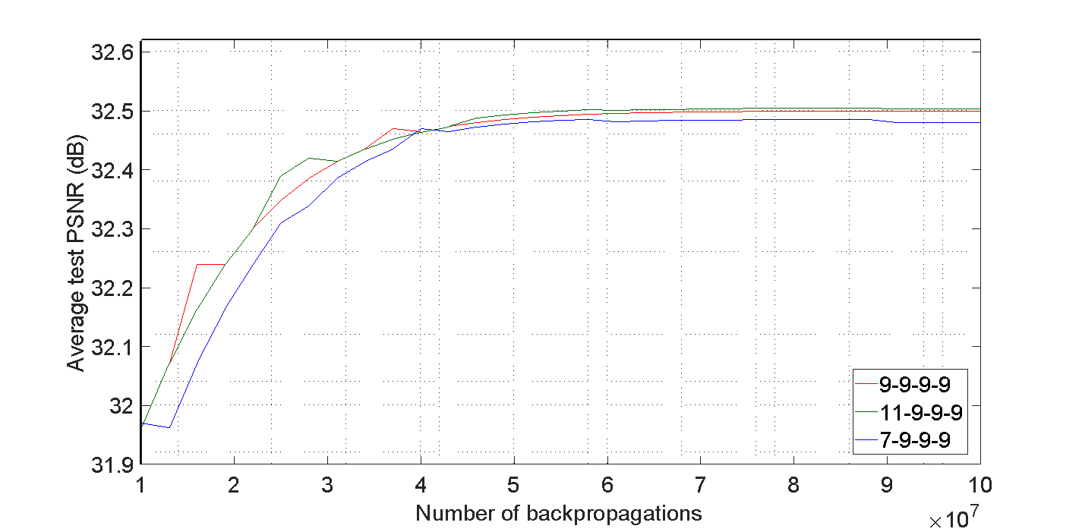
Network parameters and Efficiency
Filter size

Slide 19
Contributions
Two CNN architectures are presented to remove noise from low-dose CT images.
First network is inspired by the dictionary learning methods and a function is assigned for each layer based on this correlation.
An efficient network is presented by improving the first architecture in terms of speed and the performance.
Important parameters for each network are investigated to find the best performance.
The model is tested and the results are compared to the state-of-the-arts methods.

Slide 20
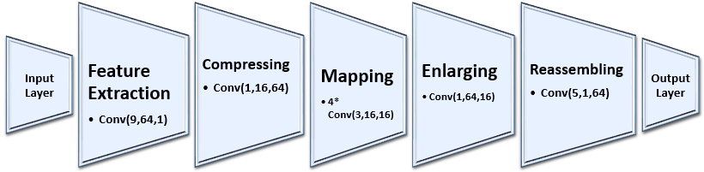
from the LDCNN to Deep-LDCNN

Slide 21
from the LDCNN to Deep-LDCNN

Slide 22
from the LDCNN to Deep-LDCNN

Slide 23
from the sparse-LDCNN to Deep-LDCNN
Compressing layer
Apply layer to reduce the computational cost (pooling layer)
Mapping layer
Adopt a wider mapping layer with the lower size of the feature maps .
Capture the non-linear property of the noise
Enlarging layer
Inverse process of the compressing layer

Slide 24
from the LDCNN to Deep-LDCNN

Slide 25
from the sparse-LDCNN to Deep-LDCNN
Reassembling layer
Reduce the size of the feature maps to enhance the sharpness

Slide 26
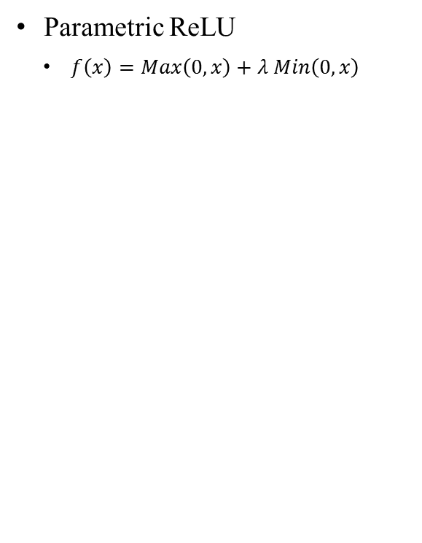
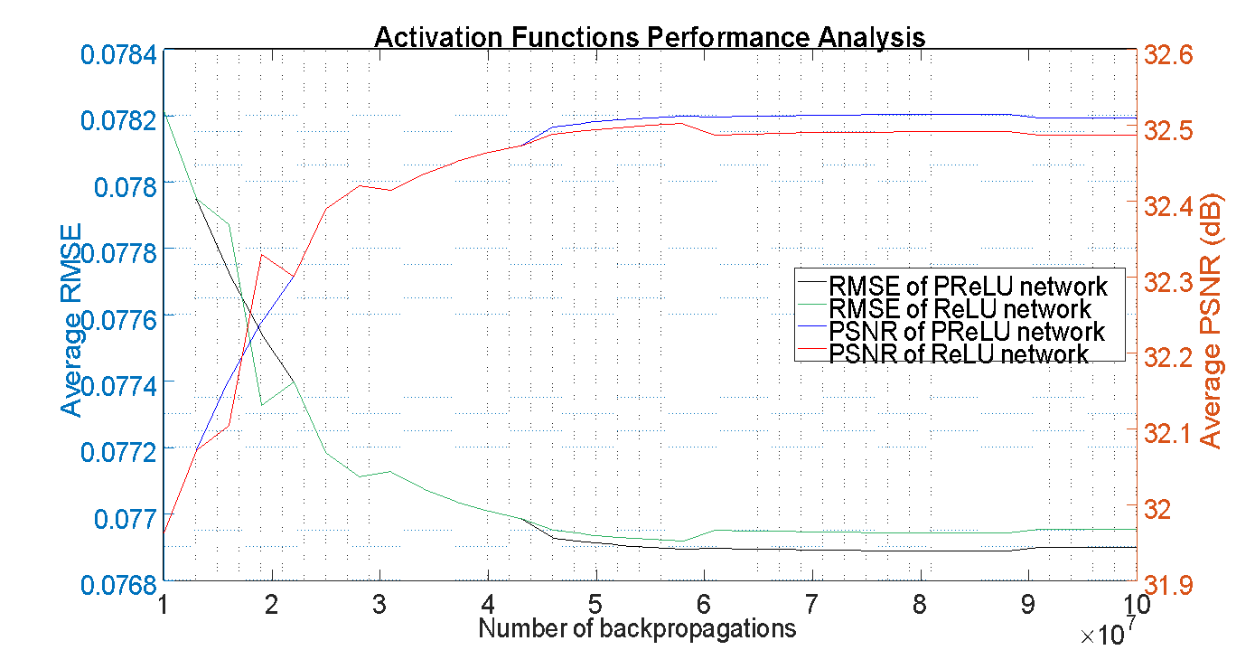
Parametric ReLU
learned parameter
Zero gradient whenever the unit is not active.
ReLU
Slow down the training process due to the constant zero gradients.

Slide 27
Network parameters and Efficiency
Size of the feature maps in the mapping layers
Symmetric
Compressing and Enlarging layers
Number of feature maps in the feature extraction layer ()
Sensitive parameters
Number of mapping layers ()
Number of feature maps in the compressing layer ()

Slide 28
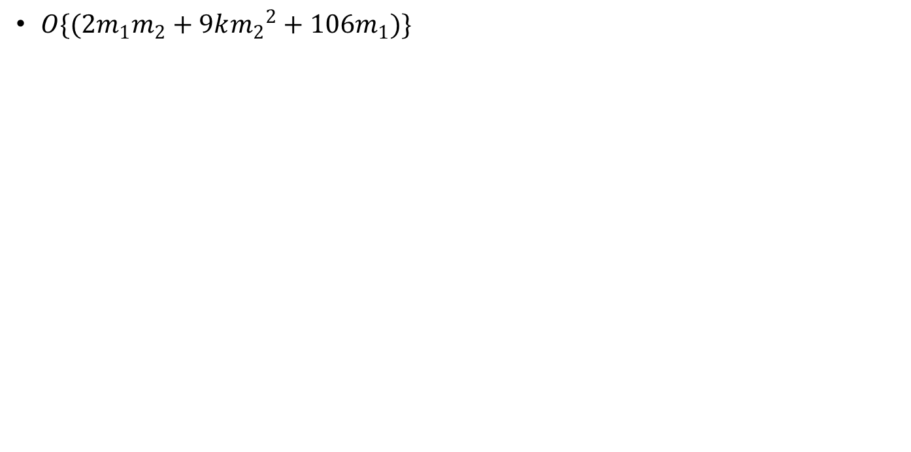
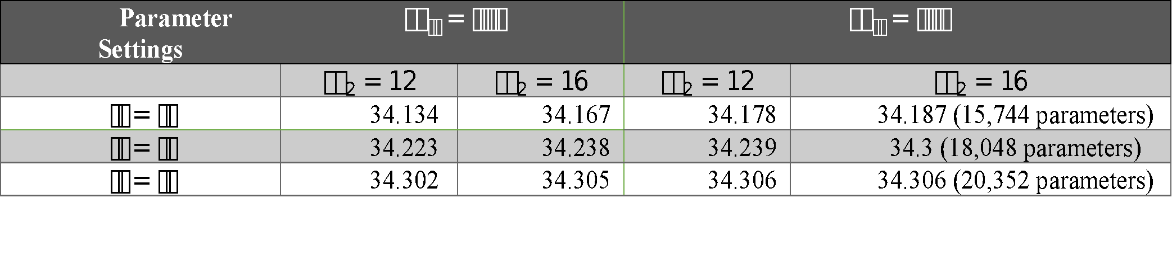
Network parameters and Efficiency

Slide 29
Implementation Details
Normalizing images and Extracting patches from CT images using the stride and patch size and create 4-D Hierarchical Data Format (HDF) file
Applying test images and evaluation metrics
Caffe implementation :Defining the layer parameters such as the number of layers, number of filters, kernel size, loss layer. Also the network parameters such as learning rate, momentum, number of iterations.
Importing the network structures from Caffe to Matlab and saving the parameters

Slide 30
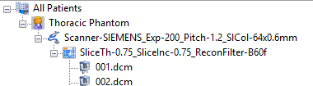
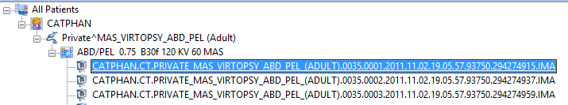
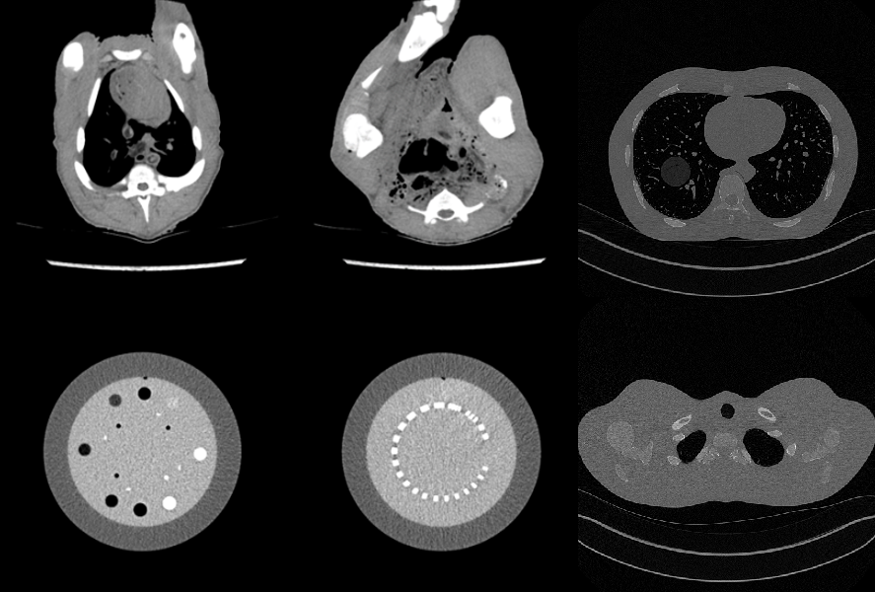
CT Datasets
Anthropomorphic thoracic phantom
407 normal-dose (200mAs) and corresponding low-dose (25mAs) CT images.
Focused on the lung nodules with different characteristics (size, density, shape, location)
CATPHAN600 phantom
584 normal-dose (210mAs) and corresponding low-dose (60mAs) CT images.
Involves line pairs of different spacing and spheres with varying contrast and is used for evaluating spatial resolutions.
Piglet dataset
906 normal-dose (300mAs) and corresponding low-dose (73,30, 15mAs) CT images.

Slide 31
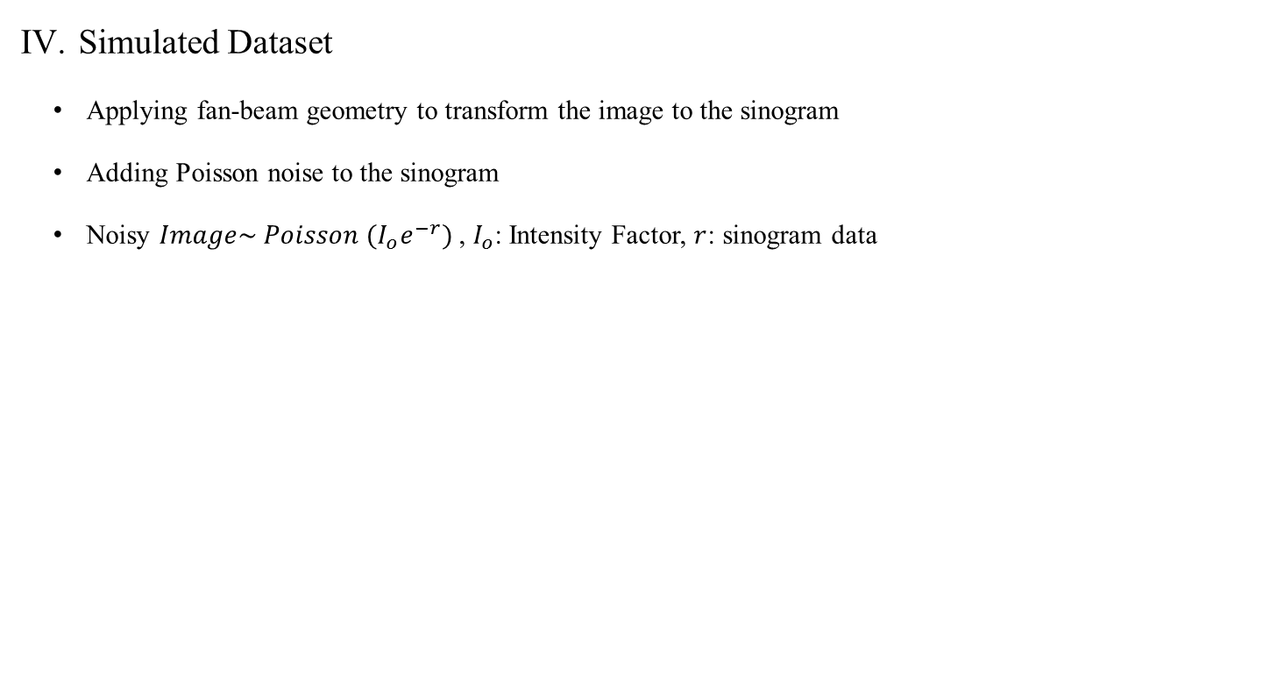
CT Datasets
Datasets Properties:
DICOM Images
Randomly Shuffled data
Training, validation, and test set involves 50%, 25%, and 25% of each dataset respectively.

Slide 32
Results- LDCNN
Thoracic dataset
Metrics | Proposed Algorithm | SSC-GSM | BM3D
PSNR | 32.112 | 28.754 | 28.298
SSIM | 0.834 | 0.786 | 0.736
RMSE | 0.248 | 0.365 | 0.385
CATPHAN 600 phantom
Metrics | Proposed Algorithm | SSC-GSM | BM3D
PSNR | 41.234 | 38.967 | 38.578
SSIM | 0.941 | 0.913 | 0.919
RMSE | 0.008 | 0.011 | 0.011

Slide 33
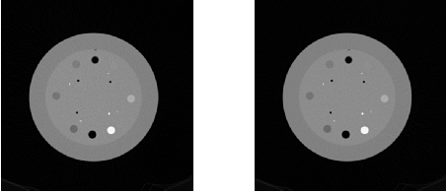
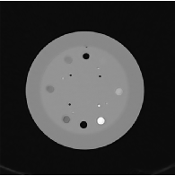
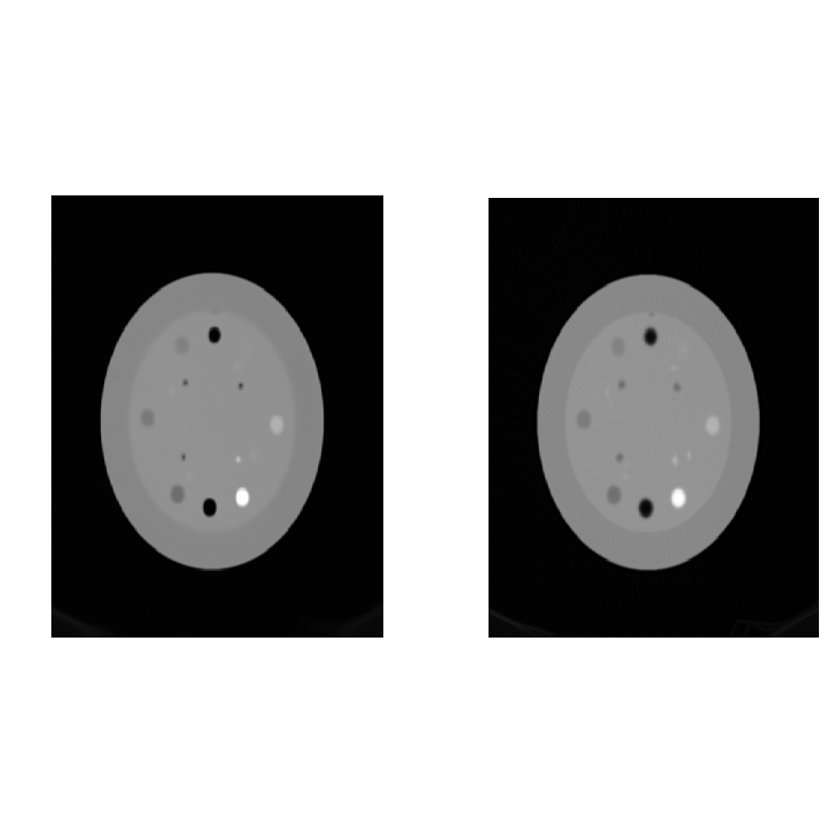

CATPHAN 600- LDCNN
left to right: Low-dose, Normal-dose, LDCNN, BM3D method [8], SSC-GSM [9]

Slide 34
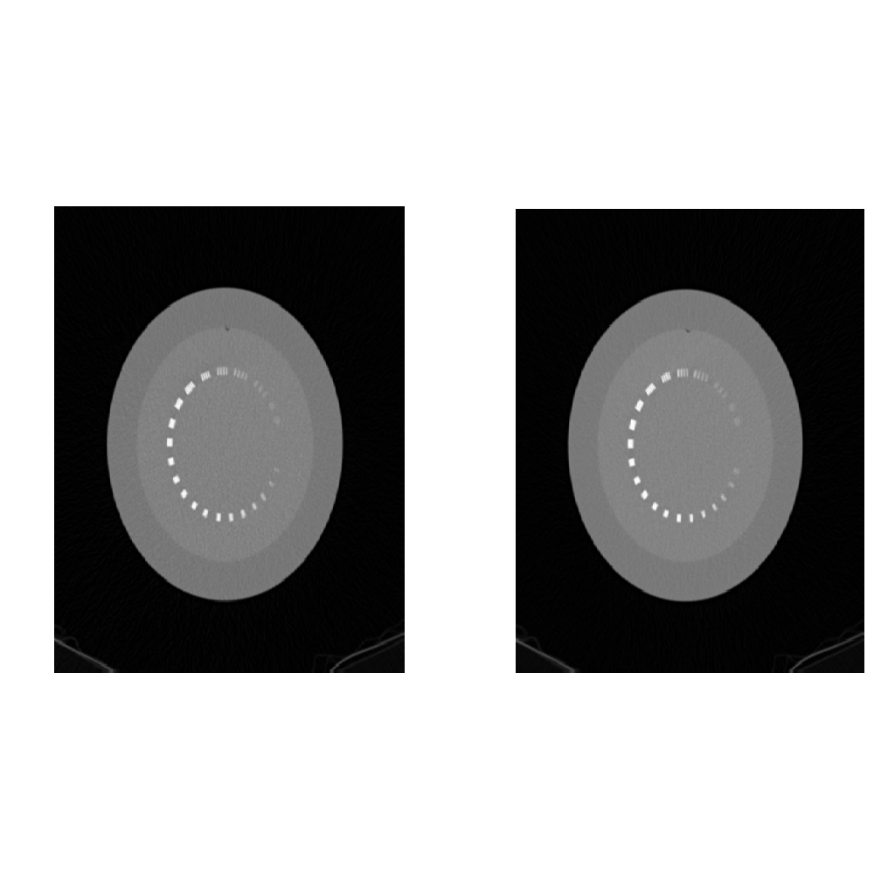
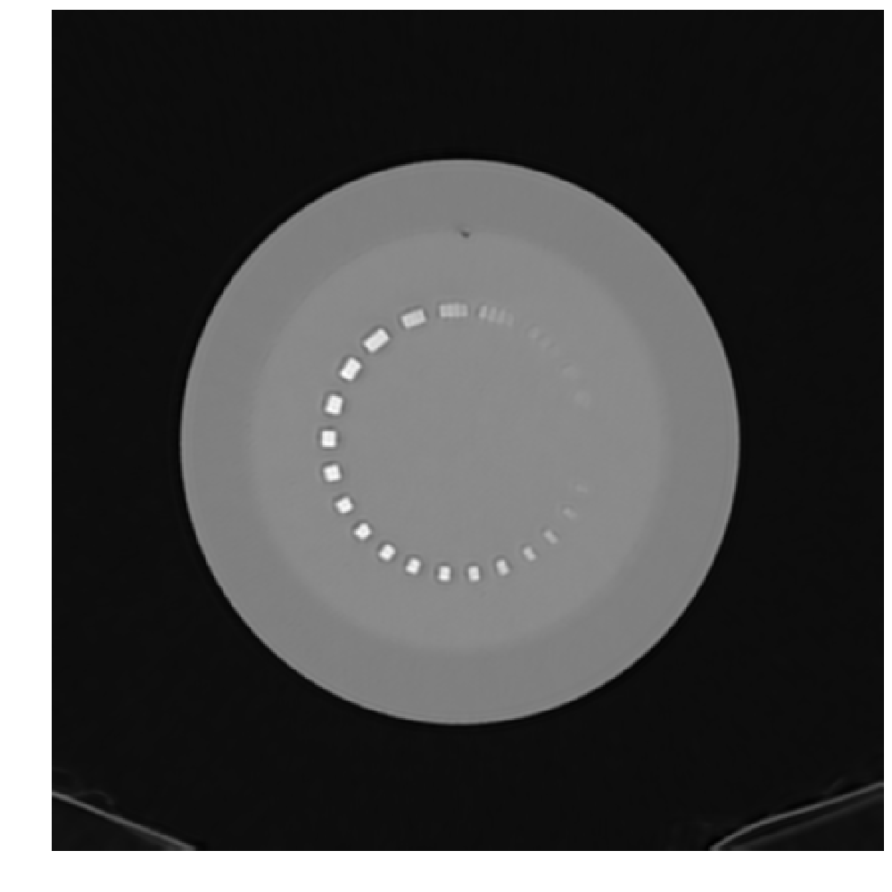

CATPHAN 600 - LDCNN
left to right: Low-dose, Normal-dose, LDCNN, BM3D method, SSC-GSM.

Slide 35
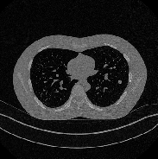
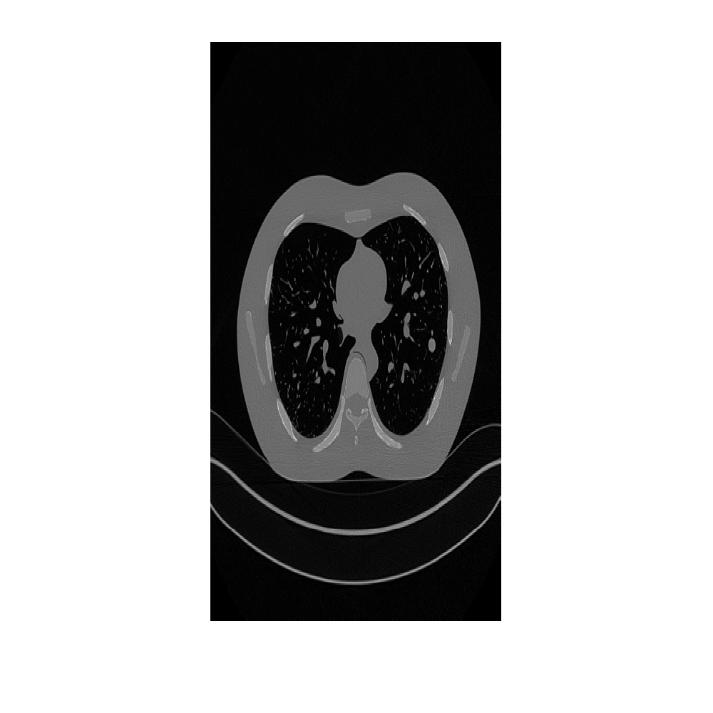
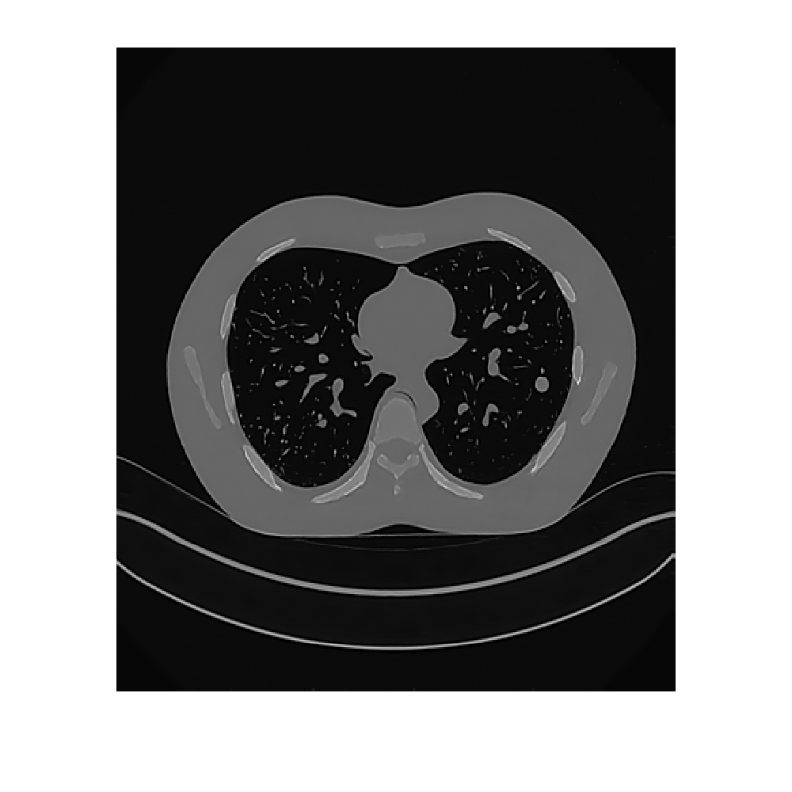
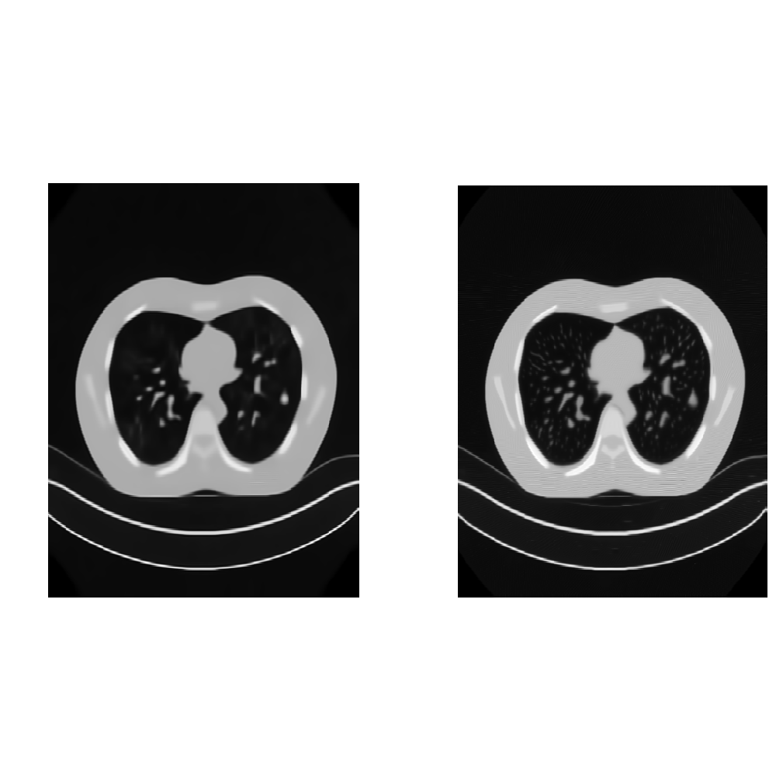
Thoracic- LDCNN
left to right: Low-dose, Normal-dose, LDCNN, BM3D method, SSC-GSM.

Slide 36
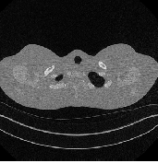
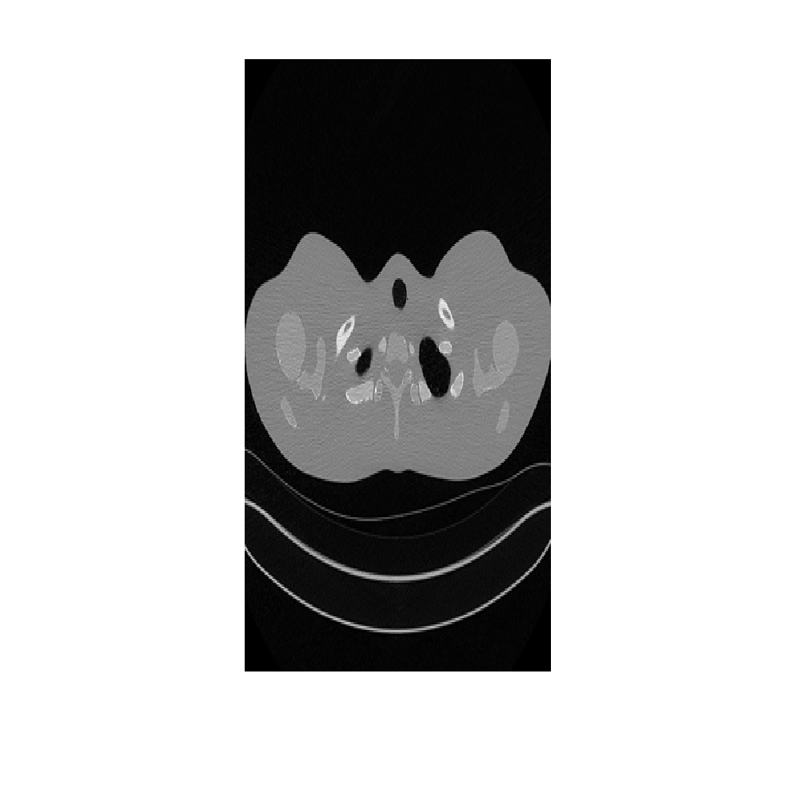
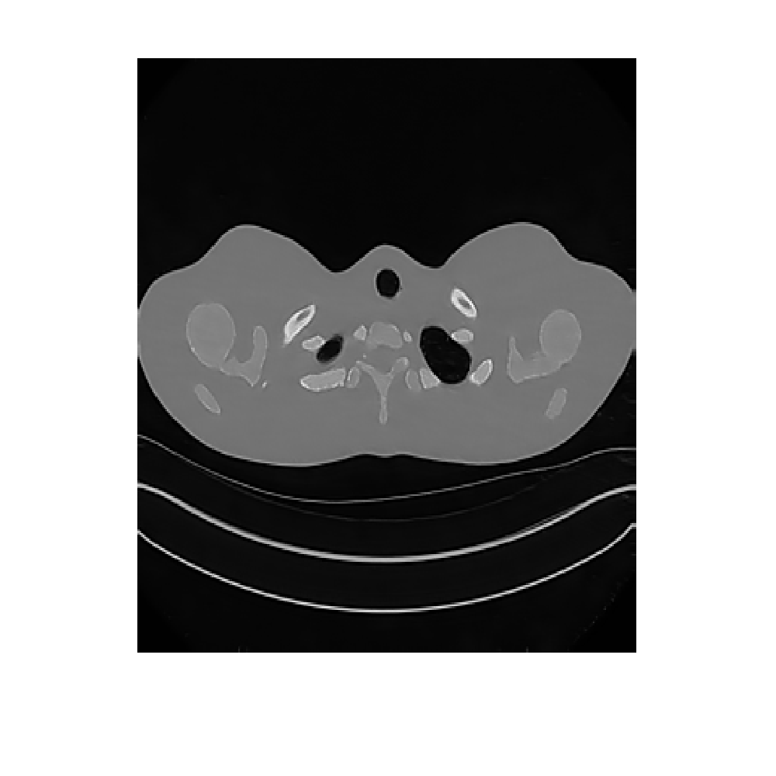
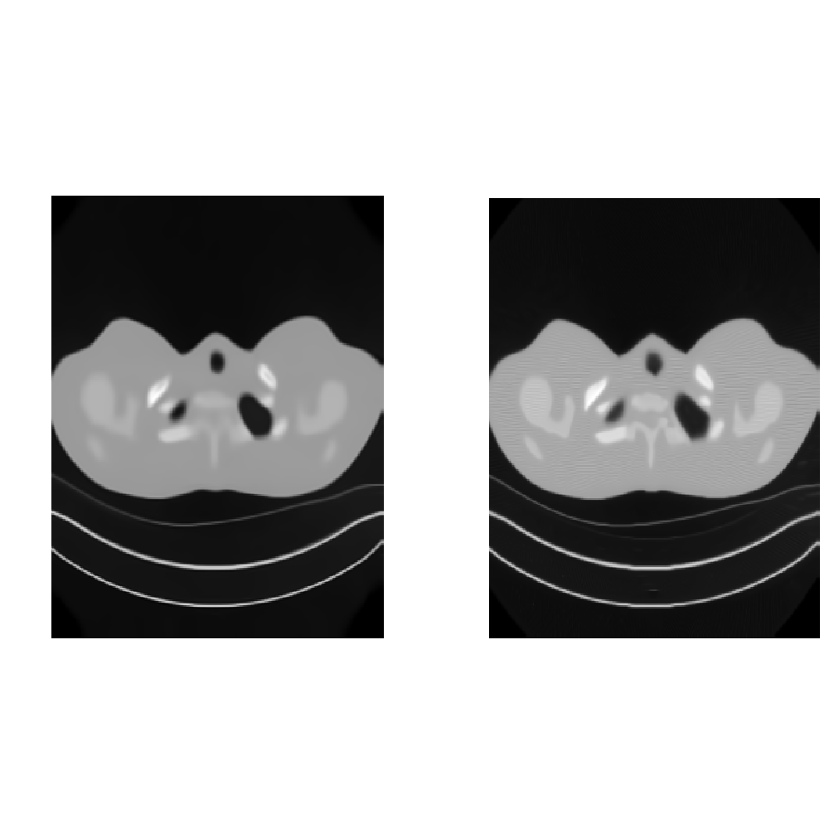
Thoracic- LDCNN
left to right: Low-dose, Normal-dose, LDCNN, BM3D method, SSC-GSM.

Slide 37
Evaluation Metrics
Peak signal-to-noise ratio (PSNR)
Root mean squared error (RMSE)
Structural Similarity (SSIM)
Multi-scale SSIM (MSSIM)
Universal quality index (UQI)
Weighted signal-to-noise ratio (WSNR)
Visual information fidelity (VIF)
Noise quality measure (NQM)
information fidelity criterion (IFC)
Quality Assessments

Slide 38
Evaluation Metrics
UQI
luminance, contrast, and structural comparisons
WSNR (dB)
Contrast sensitivity functions (CSF) are used as weights.
VIF
The amount of information shared between the source and the distorted image.
NQM (dB)
Considers variation in contrast sensitivity with distance, image dimensions and spatial frequency.
IFC
The mutual information is derived for one sub-band and then generalized for multiple sub-bands.

Slide 39
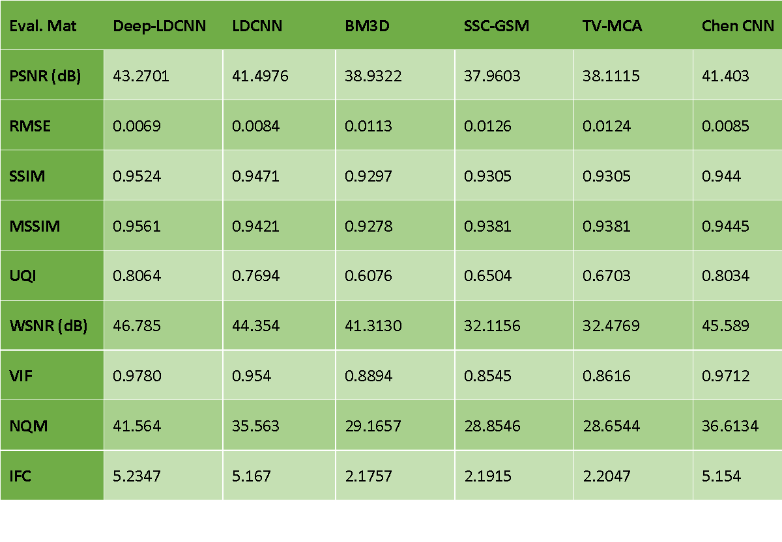
CATPHAN 600- Deep-LDCNN

Slide 40
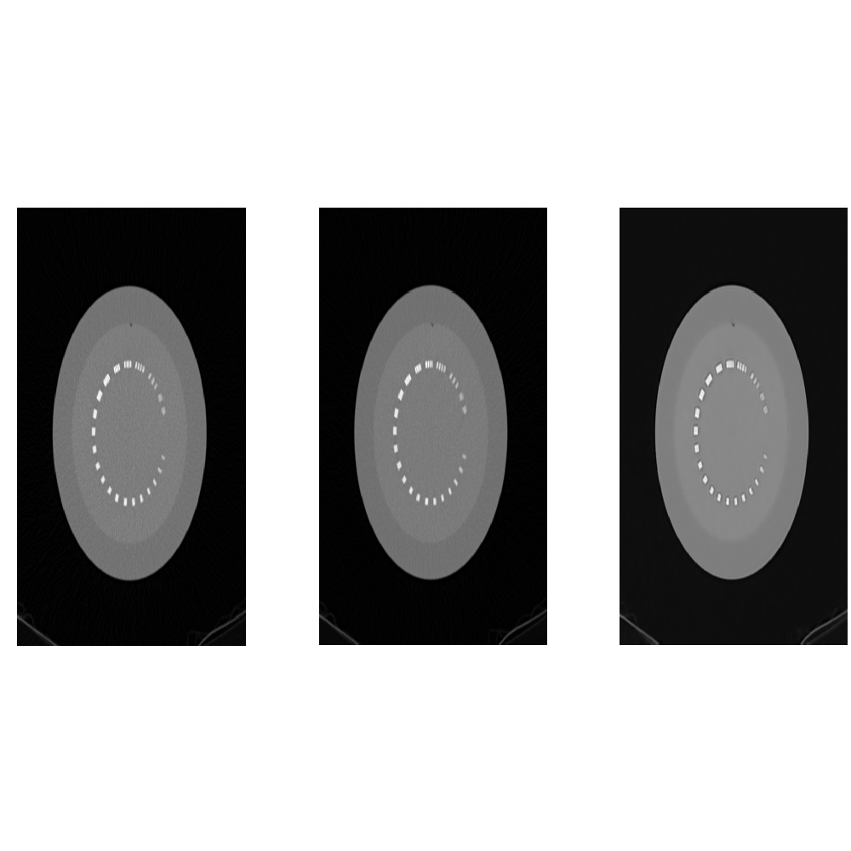
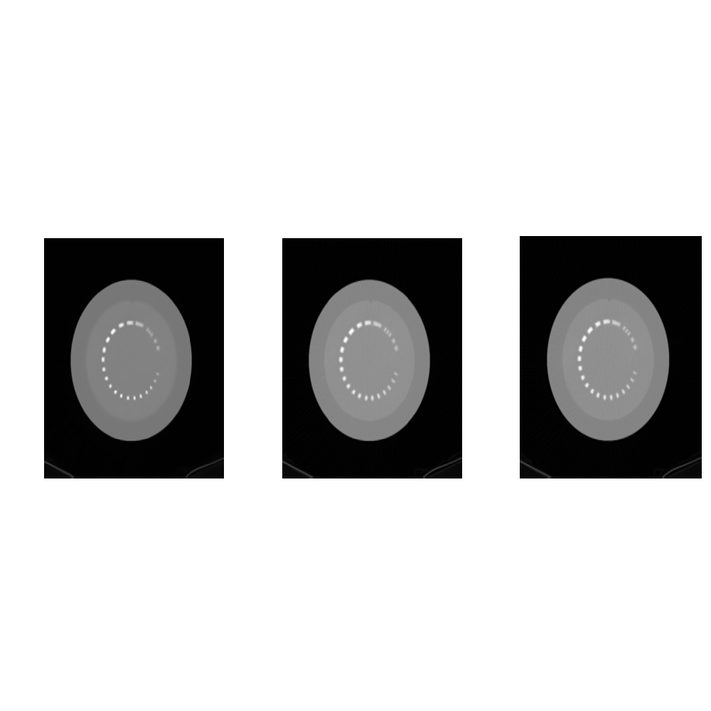


CATPHAN 600- Deep-LDCNN
left to right: Low-dose, Normal-dose, Deep- LDCNN, BM3D method, SSC-GSM method, TV-MCA method [10], LDCNN, Chen CNN [11].

Slide 41
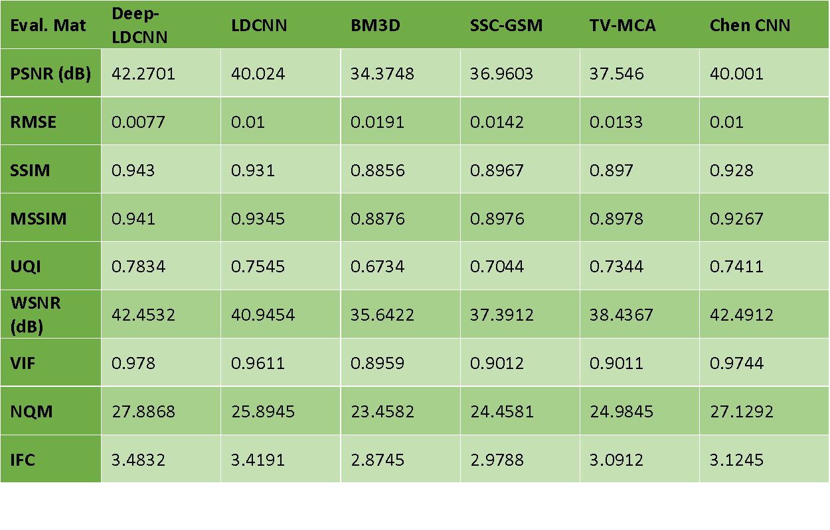
Piglet- Deep-LDCNN

Slide 42
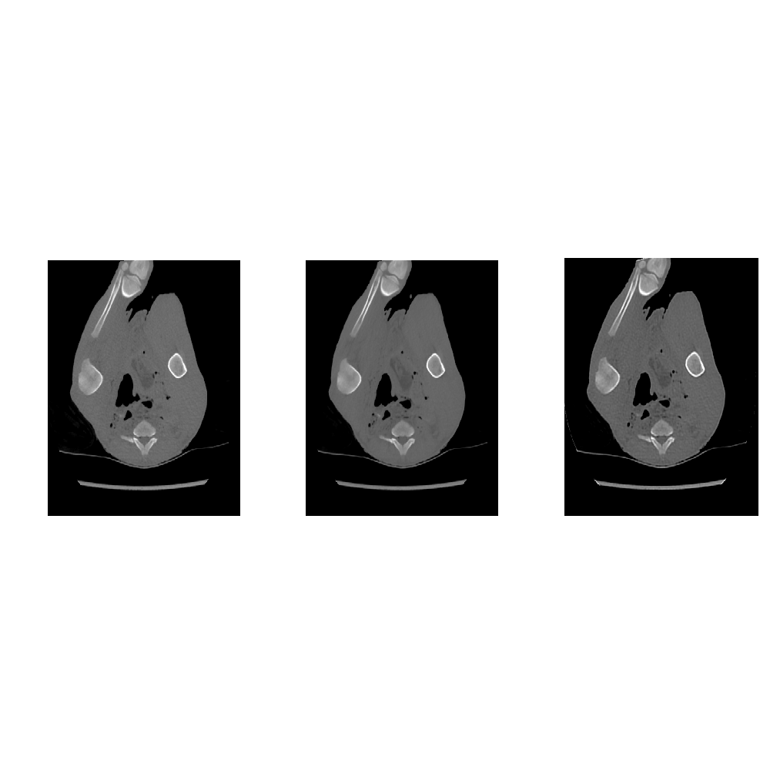
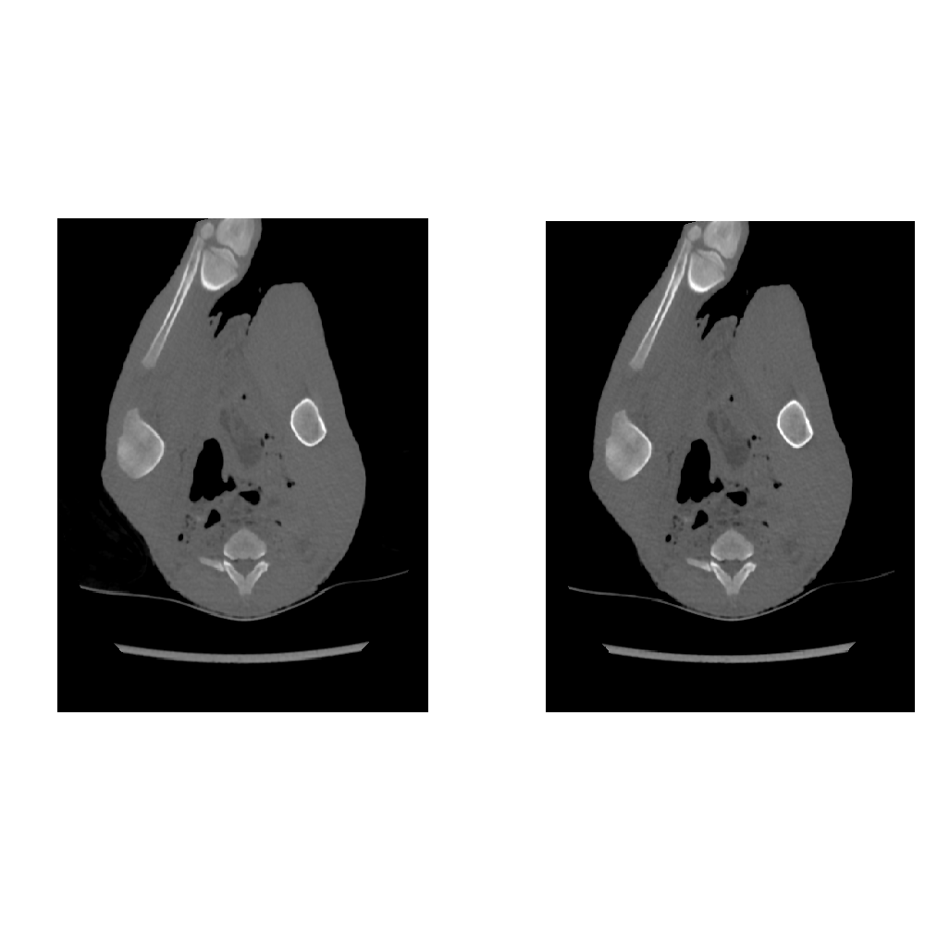
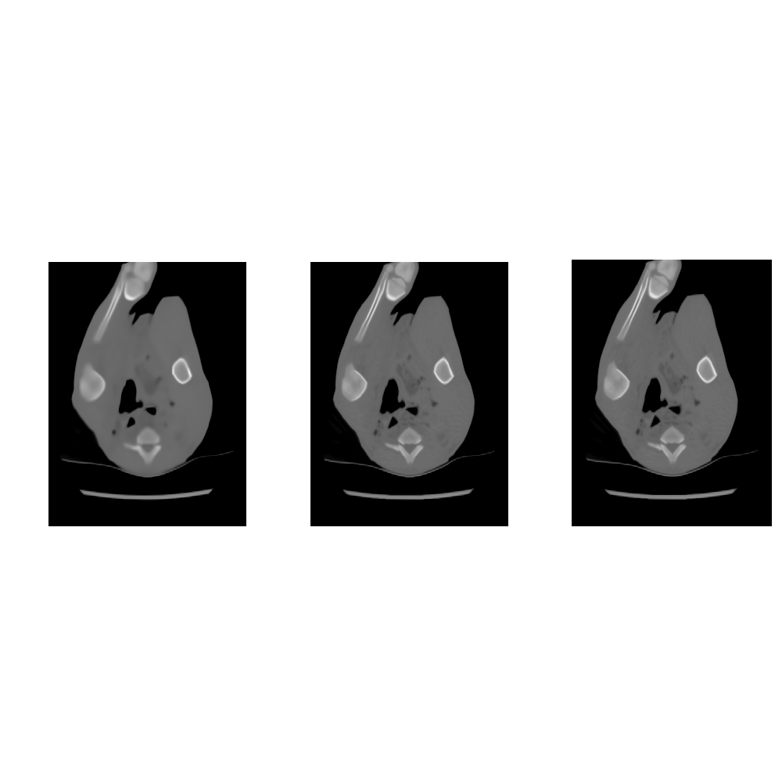
Piglet- Deep-LDCNN
left to right: Low-dose, Normal-dose, Deep- LDCNN, BM3D method, SSC-GSM method, TV-MCA method, LDCNN, Chen CNN.

Slide 43
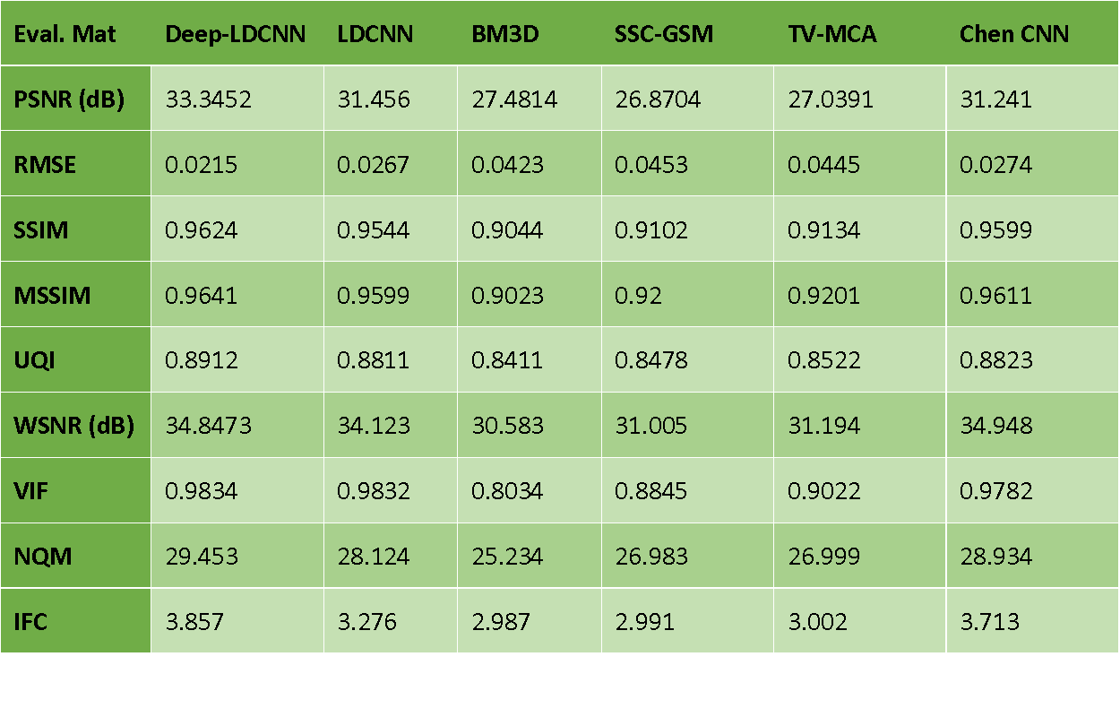
Thoracic- Deep-LDCNN

Slide 44
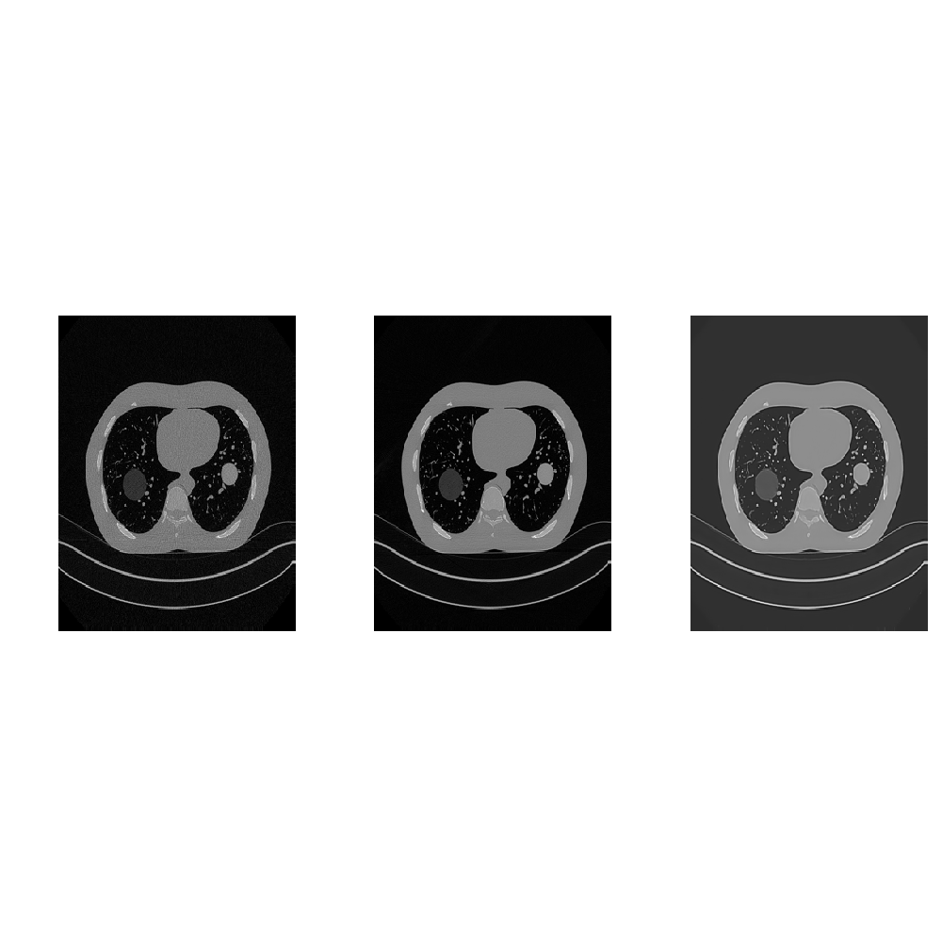
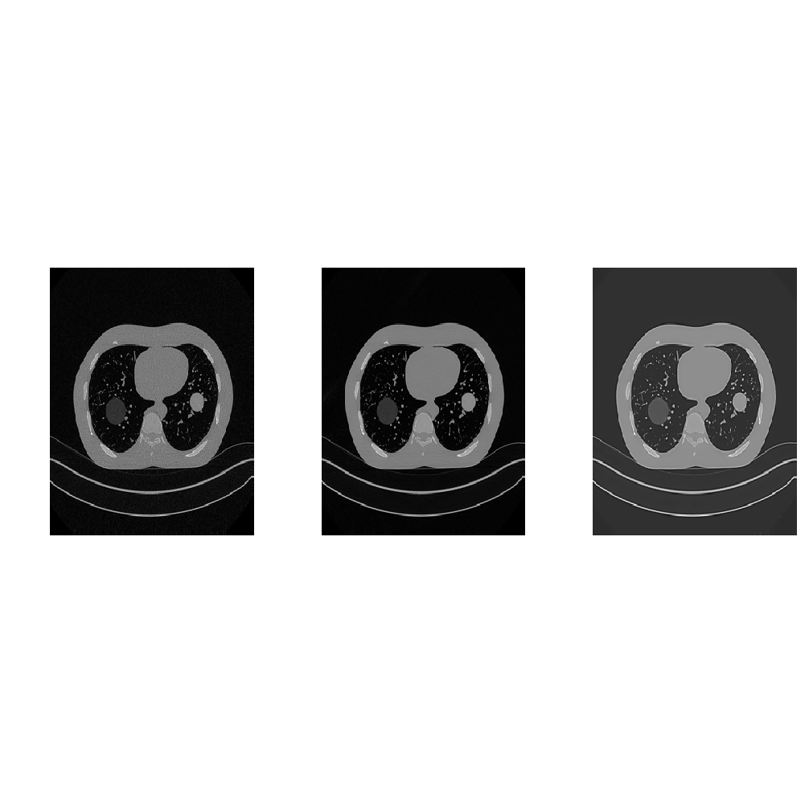
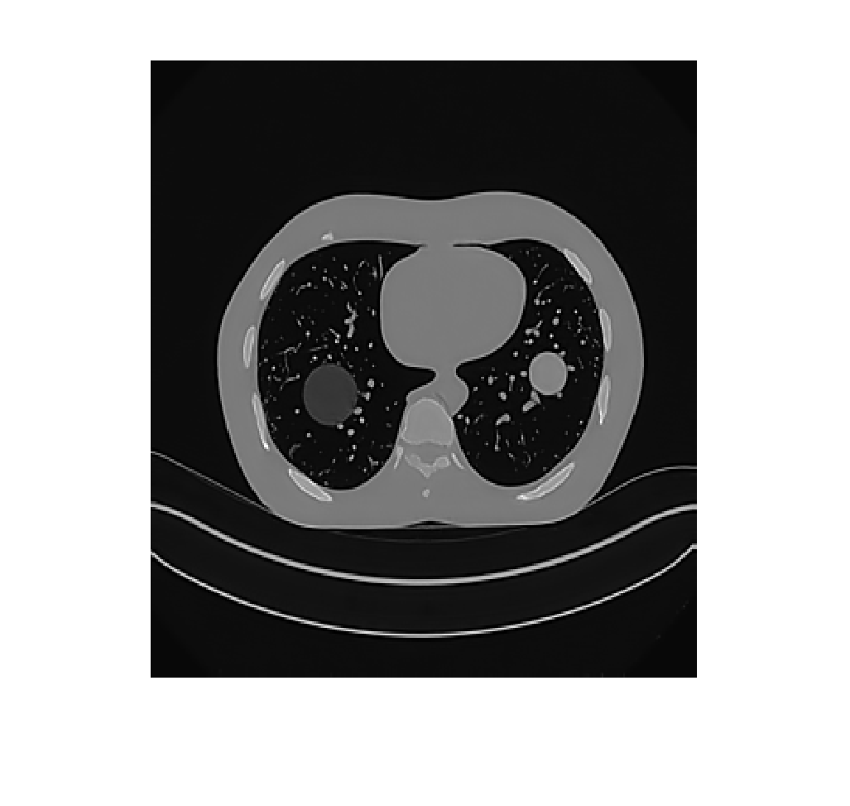
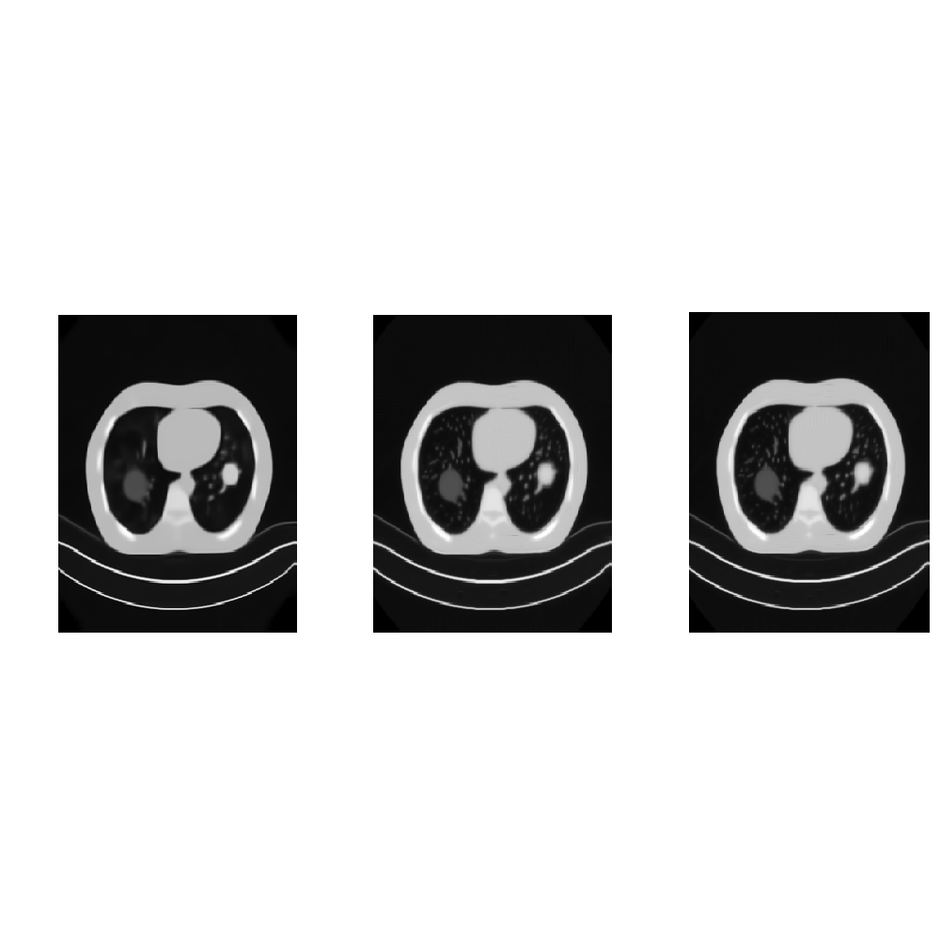
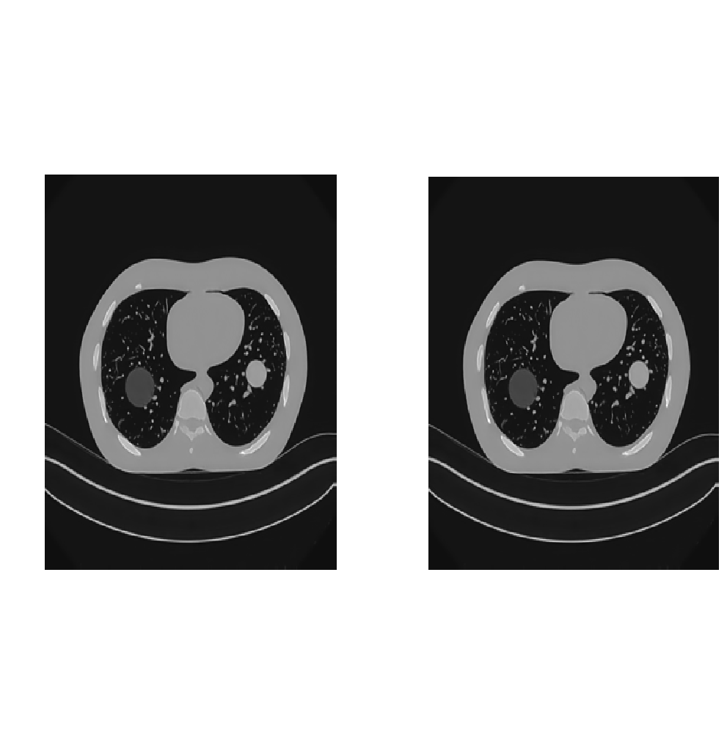

Thoracic- Deep-LDCNN
left to right: Low-dose, Normal-dose, Deep- LDCNN, BM3D method, SSC-GSM method, TV-MCA method, LDCNN, Chen CNN.

Slide 45
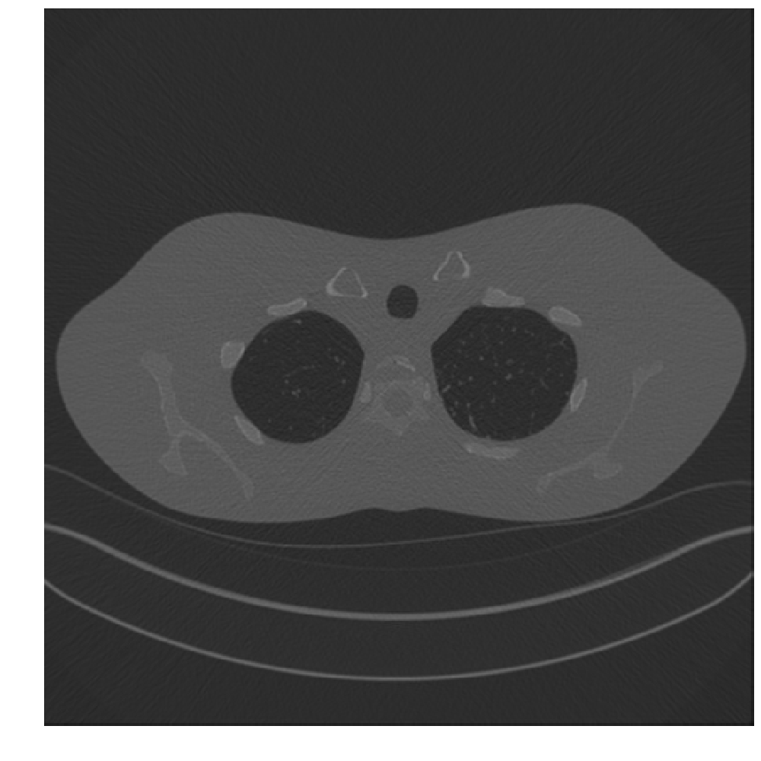

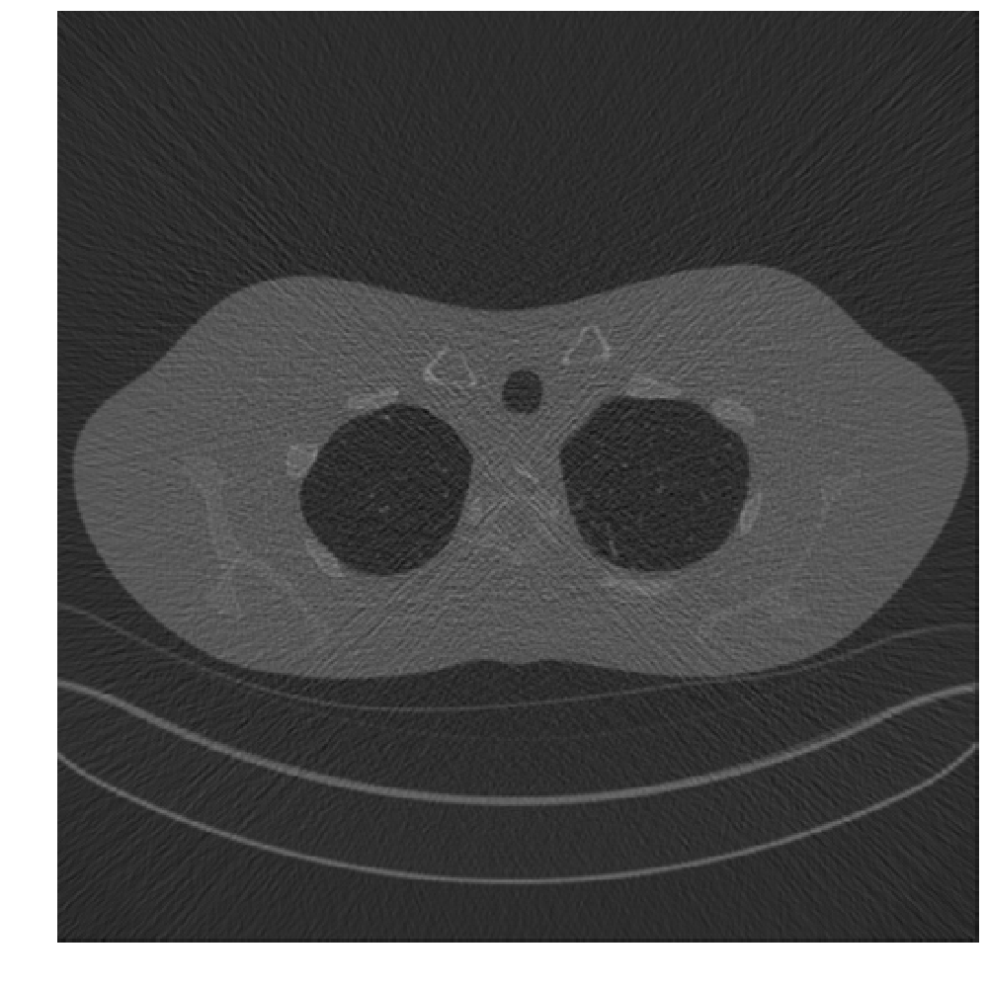

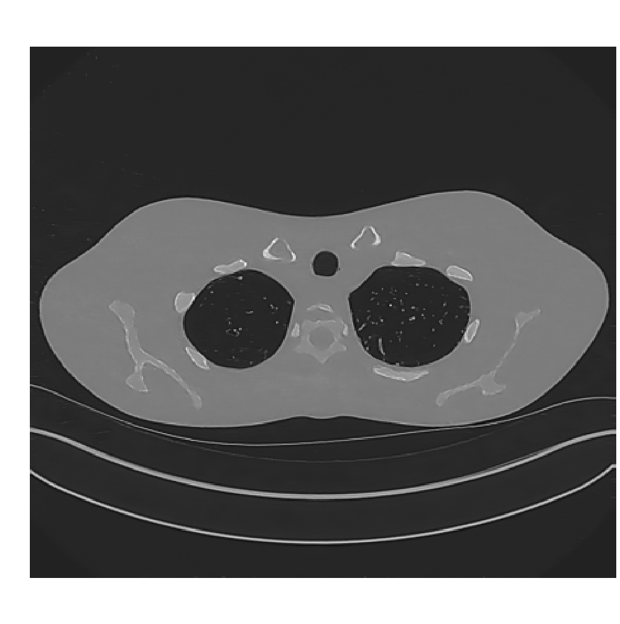
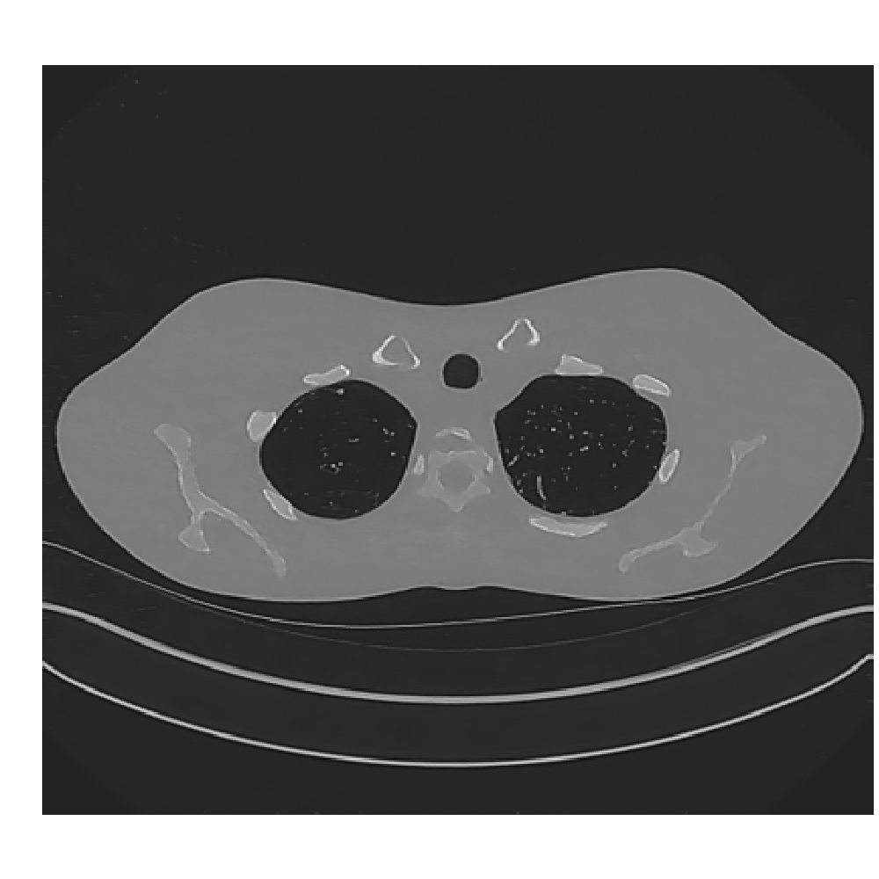

Simulated Dataset- Deep-LDCNN

Slide 46
Summary and Conclusion
Demand for low-dose CT image denoising.
The architecture, which was improved in terms of the speed and the performance was presented.
The performance outperformed other state-of-the-art methods.
The CNN architecture inspired by the dictionary methods was presented.
The parameters for each architecture were investigated to find the optimum results.

Slide 47
Contributions
Two CNN architectures are presented to remove noise from low-dose CT images.
First network is inspired by the dictionary learning methods and a function is assigned for each layer based on this correlation.
An efficient network is presented by improving the first architecture in terms of speed and the performance.
Important parameters for each network are investigated to find the best performance.
The model is tested and the results are compared to the state-of-the-arts methods.

Slide 48
Future work
Hot research areas:
Deep learning is growing fast and advanced methods are proposing.
Deep residual framework.
Generative adversarial framework.
Block-matching framework.
Improving the contrast issue in DICOM.

Slide 49
References
[1] A. C. Kak and M. Slaney, “Principles of Computerized Tomographic Imaging,” IEEE Press, vol. 4, no. Dec, pp. 1–2, 1988.
[2] F. E. Boas and D. Fleischmann, "Computed tomography artifacts: Causes and reduction techniques," Imaging in Medicine, vol. 4, no. 2, pp. 229-240, 2012.
[3] P. J. La Rivière, “Penalized-likelihood sinogram smoothing for low-dose CT,” Med. Phys., vol. 32, no. 6Part1, pp. 1676–1683, 2005.
[4] S. G. Chang, B. Yu, and M. Vetterli, “Adaptive wavelet thresholding for image denoising and compression,” IEEE Trans. Image Process., vol. 9, no. 9, pp. 1532–1546, 2000.
[5] L. I. Rudin, S. Osher, and E. Fatemi, “Nonlinear total variation based noise removal algorithms,” Phys. D Nonlinear Phenom., vol. 60, no. 1–4, pp. 259–268, 1992.
[6] S. Ghadrdan, J. Alirezaie, S. Member, J. Dillenseger, and P. Babyn. 2014. Low-dose Computed Tomography Image Denoising based on Joint Wavelet and Sparse representation. Engineering in Medicine and Biology Society (EMBC), 2014 36th Annual International Conference of the IEEE, 2014, 3325–3328.
[7] Priyam Chatterjee and Peyman Milanfar. 2009. Image denoising using locally learned dictionaries. Proceedings of SPIE 7246, 7: 72460V–72460V–10, 1438 - 1451
[8] A. Danielyan, V. Katkovnik, and K. Egiazarian, “BM3D Frames and Variational Image Deblurring”, IEEE Trans. Image Process., vol. 21, no. 4, pp. 1715-1728, April 2012.
[9] Weisheng Dong, Guangming Shi, Yi Ma, and Xin Li. 2015. Image Restoration via Simultaneous Sparse Coding: Where Structured Sparsity Meets Gaussian Scale Mixture. International Journal of Computer Vision 114, 2: 217-232.
[10] A. Khodabandeh, J. Alirezaie, P. Babyn, and A. Ahmadian, “Computed Tomography Image Denoising by Learning to Separate Morphological Diversity,” Telecommun. Signal Process. (TSP), 2015 38th Int. Conf., pp. 513–517, 2015.
[11] H. Chen, Y. Zhang, W. Zhang, P. Liao, K. Li, and J. Zhou, “LOW-DOSE CT DENOISING WITH CONVOLUTIONAL NEURAL NETWORK College of Computer Science , Sichuan University , Chengdu 610065 , China National Key Laboratory of Fundamental Science on Synthetic Vision , Sichuan University , Chengdu Department of Scientific Re,” pp. 2–5, 2017.

Slide 50
Publications
S. Badretale, F. Shaker, J. Alirezaie, P. Babyn, “Fully Convolutional Architecture for Low-Dose CT Image Noise Reduction”, Accepted and Presented in International Conference on Artificial Intelligence Applications and Technologies, 2017, USA.
S. Badretale, F. Shaker, J. Alirezaie, P. Babyn, “Deep Convolutional approach for Low-Dose CT Image Noise Reduction”, Submitted to the ICBME 2017.

Slide 51
Questions

